Slide 1
Operating Systems
Ch 8: Deadlocks
Dr. 何明昕 HE Mingxin, MX, Max
Send your email to c.max@yeah.net with
a subject like: OS-id-Andy: On What …
Download from c.program@yeah.net
/文件中心/网盘/OperatingSystems26S
Book site: https://codex.cs.yale.edu/avi/os-book/OS10/index.html

Slide 2
Outline
System Model
Deadlock Characterization
Methods for Handling Deadlocks
Deadlock Prevention
Deadlock Avoidance
Deadlock Detection
Recovery from Deadlock

Slide 3
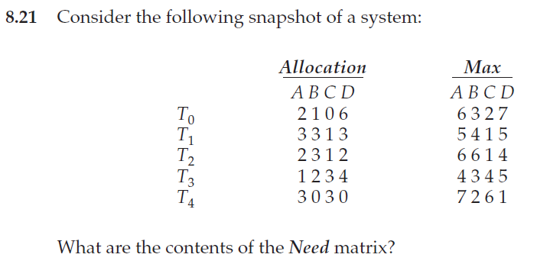
Exercises 8.21, 8.27, 8.28 (By hands only)

Slide 4
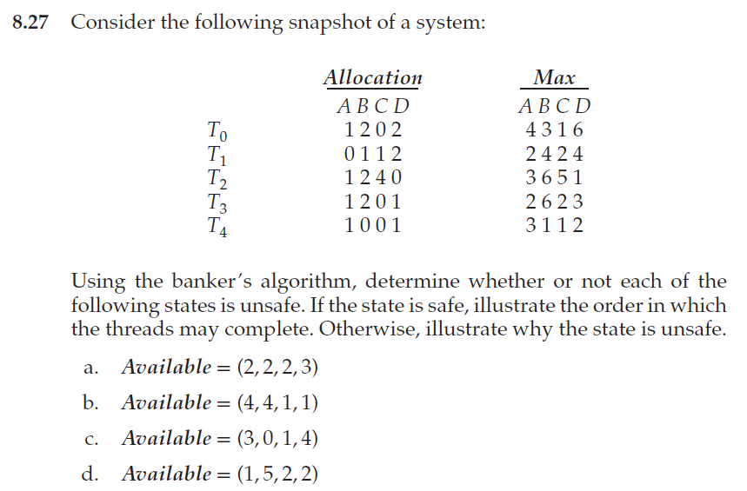
Exercises 8.21, 8.27, 8.28

Slide 5
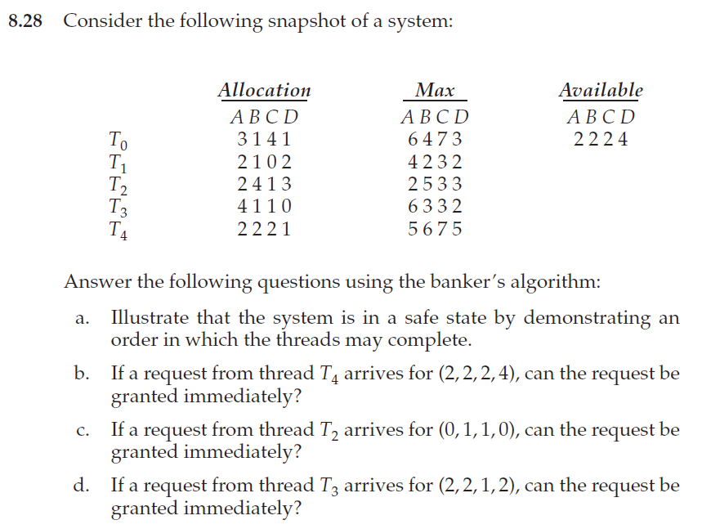
Exercises 8.21, 8.27, 8.28

Slide 6
Chapter Objectives
Illustrate how deadlock can occur when mutex locks are used
Define the four necessary conditions that characterize deadlock
Identify a deadlock situation in a resource allocation graph
Evaluate the four different approaches for preventing deadlocks
Apply the banker’s algorithm for deadlock avoidance
Apply the deadlock detection algorithm
Evaluate approaches for recovering from deadlock

Slide 7
In a multiprogramming environment, several processes may compete for a finite number of resources.
A process requests resources; if the resources are not available at that time, the process enters a waiting state.
Sometimes, a waiting process is never again able to change state, because the resources it has requested are held by other waiting processes.
This situation is called a deadlock.
In this chapter, we describe methods that an operating system can use to prevent or deal with deadlocks

Slide 8

An Example
When two trains approach each other at a crossing, both shall come to a full stop, and neither shall start up again until the other has gone
A law passed by the Kansas legislature early in the 20th century

Slide 9
System Model
System consists of a finite number of resources
A number of competing processes
Partitioned into several resource types R₁, R₂, . . ., R_{m}
CPU cycles, memory space, I/O devices
Each resource type R_{i} has W_{i} instances.
Synchronization tools, such as mutex locks and semaphores are also considered system resources
A common source of deadlock
Each process utilizes a resource in only the sequence:
request
use
release

Slide 10
Deadlock with Mutex Locks / Semaphores
The locking tools (e.g., mutex locks, semaphores) are designed to avoid race conditions. However, inappropriate usage of them can lead to deadlocks.
Example?
Deadlock – A set of processes is deadlocked when every process in the set is waiting for the resource that is currently allocated to another process in the set
Let S and Q be two semaphores initialized to 1
P₀ P₁
wait(S); wait(Q);
wait(Q); wait(S);
... ...
signal(S); signal(Q);
signal(Q); signal(S);

Slide 11
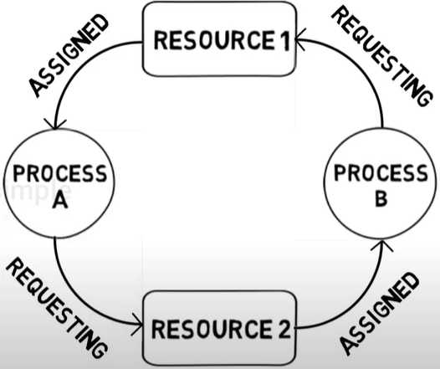
Deadlock Example

Slide 12
Deadlock Characterization
Deadlock can arise if four conditions hold simultaneously.
Mutual exclusion: at least one resource must be held in a non-sharable mode; that is, only one process at a time can use a resource
Hold and wait: a process must be holding at least one resource and waiting to acquire additional resources held by other processes
No preemption: Resources cannot be preempted; that is, a resource can be released only voluntarily by the process holding it, after that process has completed its task
Circular wait: A set {P₀, P₁, …, P_{n}} of waiting processes such that P₀ is waiting for a resource that is held by P₁, P₁ is waiting for a resource that is held by P₂, …, P_{n–1} is waiting for a resource that is held by P_{n}, and P_{n} is waiting for a resource that is held by P₀.
The circular-wait condition implies the hold-and-wait condition

Slide 13
Resource-Allocation Graph
Deadlocks can be described more precisely in terms of a directed graph called a system resource-allocation graph
A set of vertices V and a set of edges E.
V is partitioned into two types:
P = {P₁, P₂, …, P_{n}}, the set consisting of all the processes in the system
R = {R₁, R₂, …, R_{m}}, the set consisting of all resource types in the system
request edge – directed edge P_{i} → R_{j}
assignment edge – directed edge R_{j} → P_{i}

Slide 14
Resource-Allocation Graph (Cont.)
Process
Resource Type with 4 instances
P_{i} requests instance of R_{j}
P_{i} is holding an instance of R_{j}
P_{i}
R_{j}
P_{i}
R_{j}

Slide 15
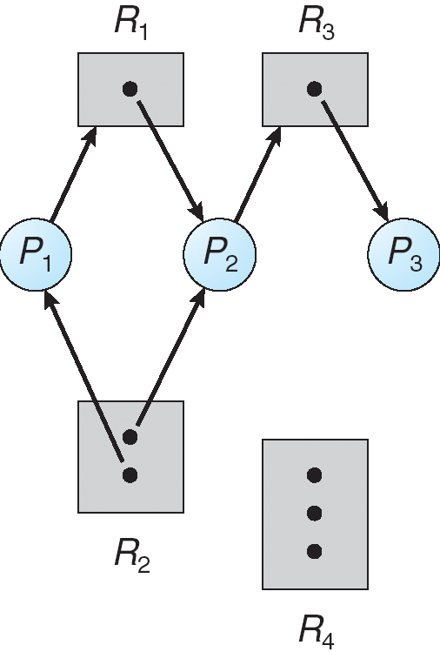
Example of a Resource Allocation Graph
Do we have a deadlock here?
It can be shown that if the graph contains no cycles, then no process in the system is deadlocked

Slide 16
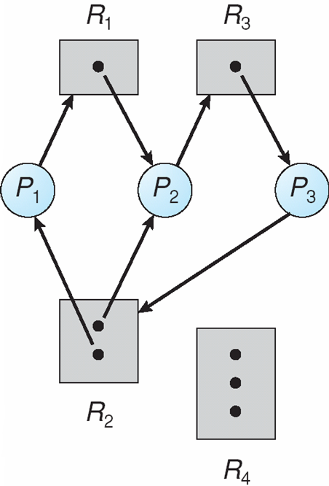

Resource Allocation Graph With A Deadlock
Processes P1, P2, and P3 are deadlocked. Process P2 is waiting for the resource R3, which is held by process P3. Process P3 is waiting for either process P1 or process P2 to release resource R2. In addition, process P1 is waiting for process P2 to release resource R1.
Two minimal cycles:
Do we have a deadlock here?

Slide 17


Graph With A Cycle But No Deadlock
If the graph does contain a cycle, then a deadlock may exist
Observe that process P4 may release its instance of resource type R2. That resource can then be allocated to P3, breaking the cycle.
Do we have a deadlock here?

Slide 18
Basic Facts
If graph contains no cycles ⇒ no deadlock
If graph contains a cycle ⇒
if only one instance per resource type, then deadlock
if several instances per resource type, possibility of deadlock

Slide 19
Quiz
Assume 3 processes share 4 identical resources, and
each allocation or request can obtain only 1 unit at a time.
Given that every process requires at most 2 units of the resource,
will a deadlock occur in the system? Explain why.
A deadlock will not occur.
Because there are 4 units of the resource for 3 processes, the pigeonhole principle guarantees that at least one process must receive two units.
Since a process needs no more than two units in total, that process can finish its execution and then release its resources.
Once those units are freed, the remaining processes can acquire the resources they need and complete their execution.
Therefore, every process will eventually obtain the required resources and finish within a finite time, preventing any deadlock in the system.

Slide 20
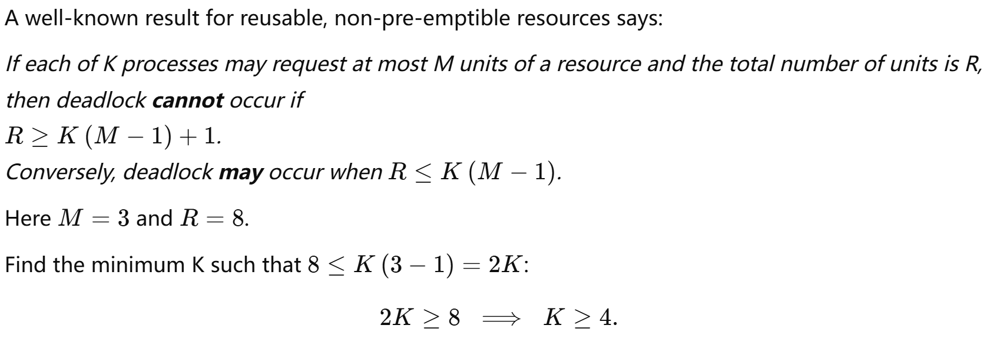
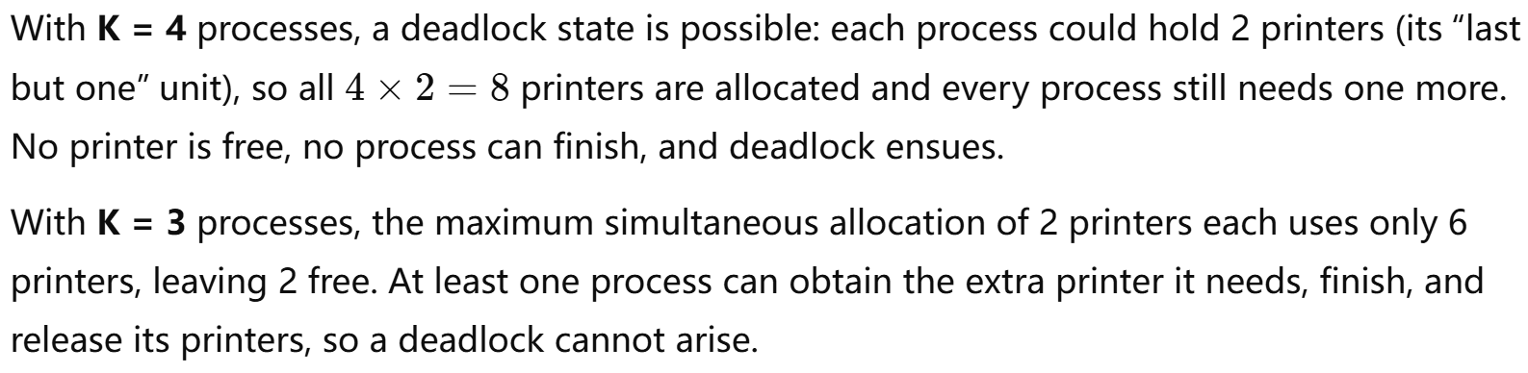
Quiz
A computer system has 8 printers shared by K processes. Each process may request up to 3 printers. What is the smallest value of K for which a deadlock could occur in the system?

Slide 21
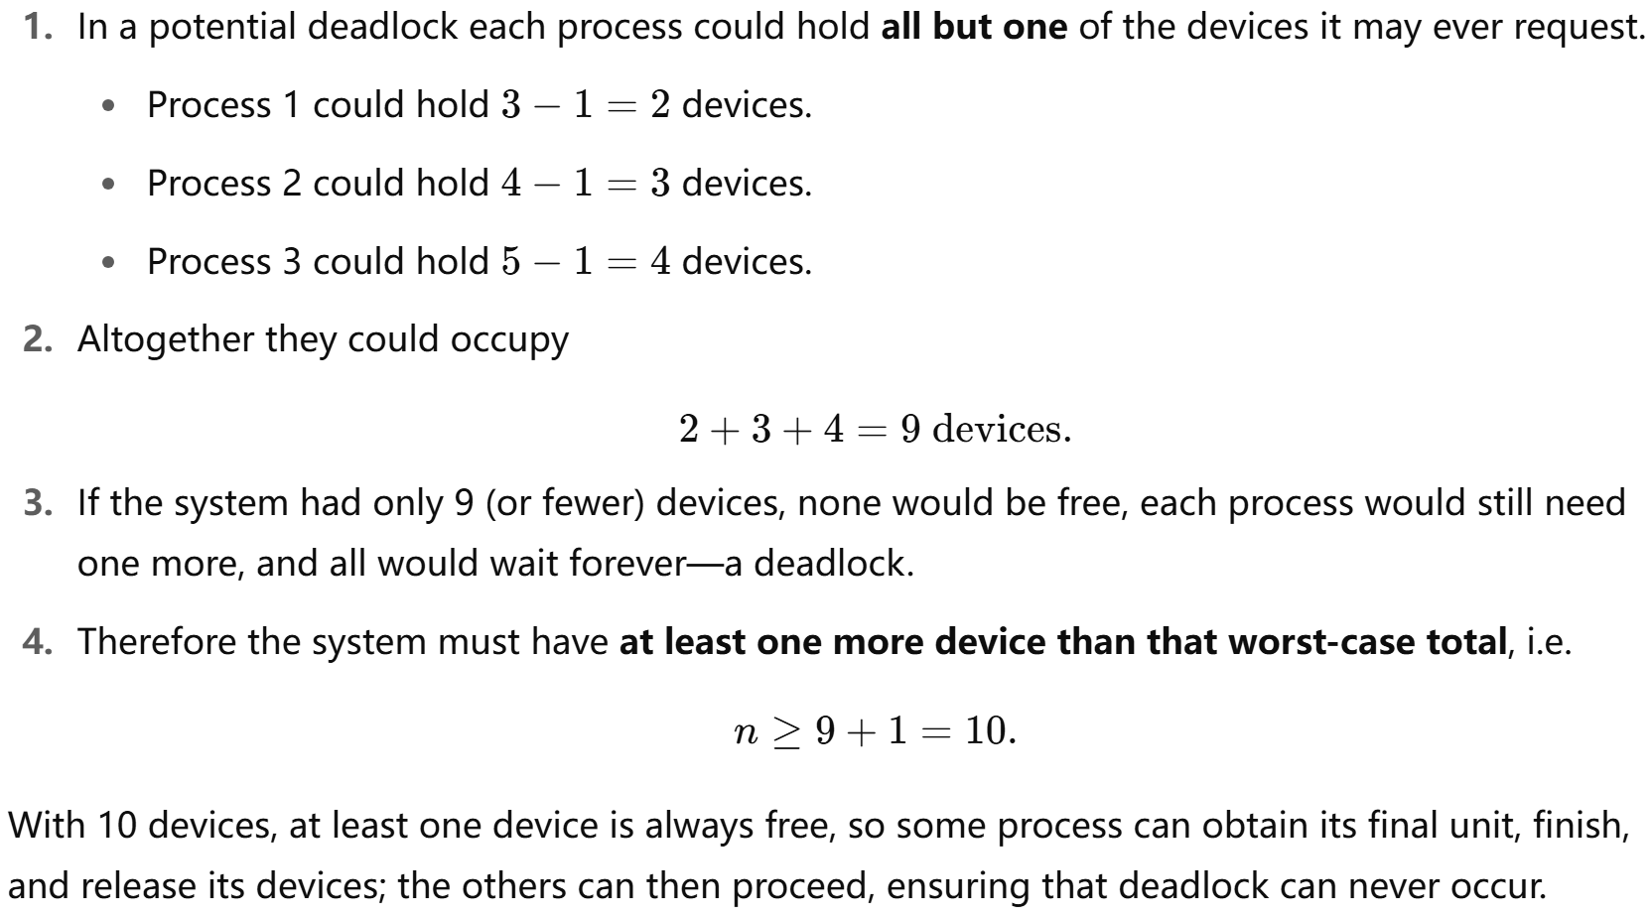
Quiz
A system contains n identical devices that can be used only one at a time (mutual exclusion).
Three concurrent processes may need up to 3, 4, and 5 devices, respectively. What is the smallest number n that guarantees the system can never enter a deadlock?

Slide 22
Methods for Handling Deadlocks
Deadlock prevention
Ensure that at least one of the necessary conditions cannot hold
Deadlock avoidance
Requires that the OS be given additional information in advance concerning which resources a process will request and use during its lifetime
Detection & Recovery
Allow the system to enter a deadlock state, detect it, and then recover

Slide 23
Deadlock Prevention
Mutual Exclusion – not required for sharable resources (e.g., read-only files); must hold for non-sharable resources
We cannot prevent deadlocks by denying the mutual-exclusion condition

Slide 24
Deadlock Prevention
Hold and Wait – must guarantee that whenever a process requests a resource, it does not hold any other resources
Method 1: Require process to request and be allocated all its resources before it begins execution, disadvantage?
Method 2: Allow process to request resources only when the process has none allocated to it.
Before request, first release all
Consider a process that copies data from a DVD driver to a file on disk, sorts the file, and then prints the results to a printer
Method 1: request all three resources in the beginning
Method 2: request DVD and disk file first; copy from DVD to disk file; release both DVD and file; and then request disk file and printer
Low resource utilization; starvation possible, why?

Slide 25
Deadlock Prevention
Consider a process that copies data from a DVD driver to a file on disk, sorts the file, and then prints the results to a printer
Method 1: request all three resources in the beginning
Method 2: request DVD and disk file first; copy from DVD to disk file; release both DVD and file; and then request disk file and printer
Low resource utilization; starvation possible, why?
Resource utilization may be low, since resources may be allocated but unused for a long period.
A process that needs several popular resources may have to wait indefinitely, because at least one of the resources that it needs is always allocated to some other process.

Slide 26
Deadlock Prevention (Cont.)
No Preemption –
If a process that is holding some resources requests another resource that cannot be immediately allocated to it, then all resources currently being held are preempted (released)
Preempted resources are added to the list of resources for which the process is waiting
Process will be restarted only when it can regain its old resources, as well as the new ones that it is requesting

Slide 27
Deadlock Prevention (Cont.)
Circular Wait – impose a total ordering of all resource types, and require that each process requests resources in an increasing order of enumeration
F(tape drive) = 1; F(disk drive) = 5; F(printer) = 12
A process can initially request any number of instances of a resource type---say, R_{i}. After that, the process can request instances of resource type R_{j} if and only if F(R_{j}) > F(R_{i})
Alternatively, we can require that a process requesting an instance of resource type R_{j} must have released any resources R_{i} such that F(R_{i}) > F(R_{j})
If these two protocols are used, then the circular-wait condition cannot hold

Slide 28
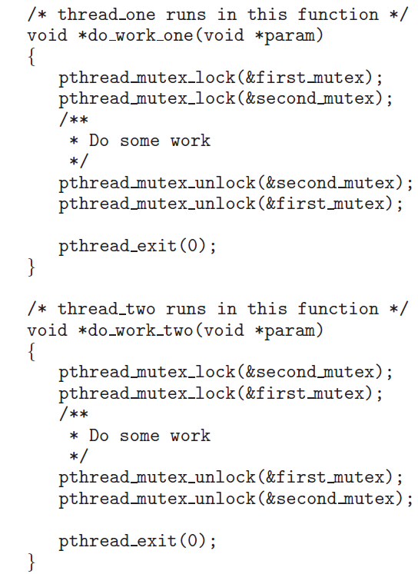
Deadlock Example
If the lock ordering was:
F(first_mutex) = 1
F(second_mutex) = 5
The thread_two could not request the locks out of order

Slide 29
Deadlock Avoidance
Requires that the system has some additional information available, about how resources are to be request
Simplest and most useful model requires that each process declare the maximum number of resources of each type that it may need
The deadlock-avoidance algorithm dynamically examines the resource-allocation state to ensure that there can never be a circular-wait condition
Resource-allocation state is defined by the number of available and allocated resources, and the maximum demands of the processes
Need priori information

Slide 30


Deadlock Avoidance
Process P will request first the tape drive and then the printer before releasing both resources?
Whereas process Q will request first the printer and then the tape drive?
With this knowledge of the complete sequence of requests and releases for each process, the system can decide for each request whether or not the process should wait in order to avoid a possible future deadlock.

Slide 31

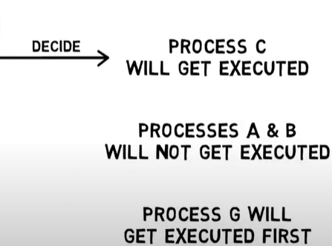
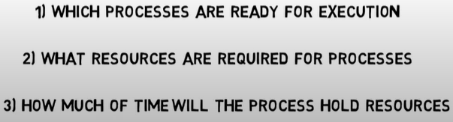
Deadlock Avoidance
Just avoiding problem when it is about to happens

Slide 32
Safe State
When a thread requests an available resource, system must decide if immediate allocation leaves the system in a safe state
System is in safe state if there exists a sequence <T₁, T₂, …, T_{n}> of ALL the threads in the systems such that for each T_{i}, the resources that T_{i} can still request can be satisfied by currently available resources + resources held by all the T_{j}, with j < I
That is:
If T_{i} resource needs are not immediately available, then T_{i} can wait until all T_{j} have finished
When T_{j} is finished, T_{i} can obtain needed resources, execute, return allocated resources, and terminate
When T_{i} terminates, T_{i +1} can obtain its needed resources, and so on

Slide 33
Basic Facts
If a system is in safe state ⇒ no deadlocks
If a system is in unsafe state ⇒ possibility of deadlock
Avoidance ⇒ ensure that a system will never enter an unsafe state.

Slide 34
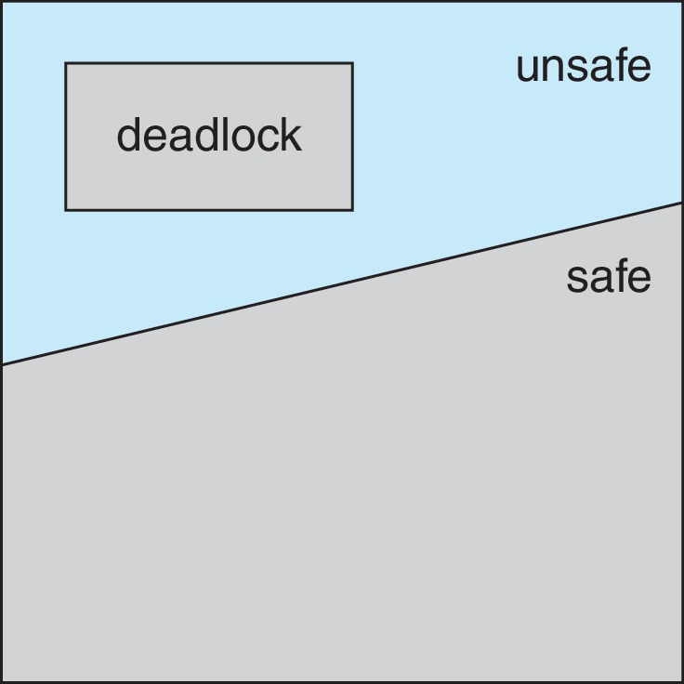
Safe, Unsafe, Deadlock State

Slide 35
Avoidance Algorithms
Single instance of a resource type
Use a resource-allocation graph
Multiple instances of a resource type
Use the Banker‘s Algorithm

Slide 36
Resource-Allocation Graph Scheme
Claim edge T_{i} → R_{j} indicated that process T_{j} may request resource R_{j}; represented by a dashed line
Claim edge converts to request edge when a thread requests a resource
Request edge converted to an assignment edge when the resource is allocated to the thread
When a resource is released by a thread, assignment edge reconverts to a claim edge
Resources must be claimed a priori in the system

Slide 37
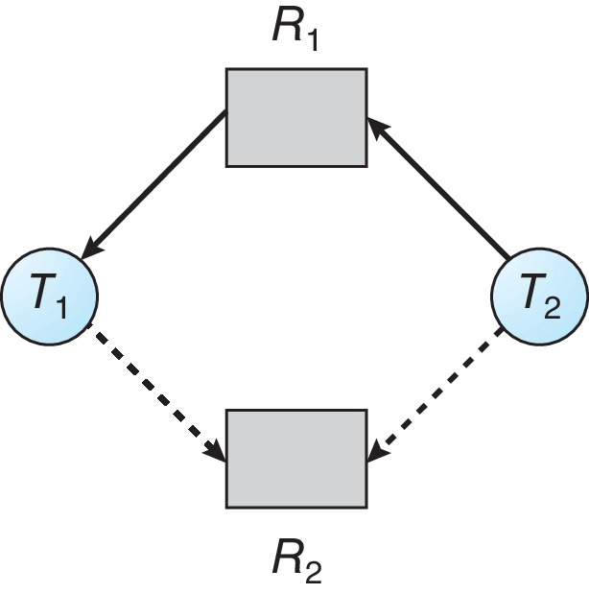
Resource-Allocation Graph

Slide 38
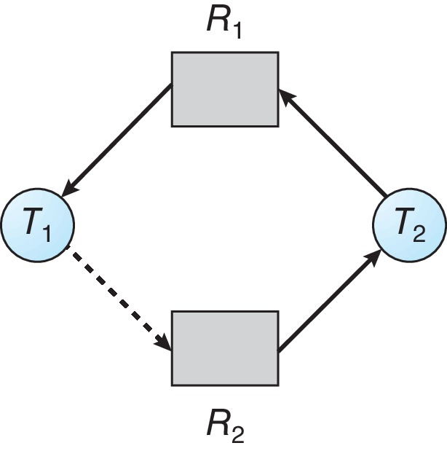
Unsafe State In Resource-Allocation Graph

Slide 39
Resource-Allocation Graph Algorithm
Suppose that thread T_{i} requests a resource R_{j}
The request can be granted only if converting the request edge to an assignment edge does not result in the formation of a cycle in the resource allocation graph

Slide 40
Banker’s Algorithm
A resource allocation and deadlock avoidance algorithm
Tests for safety by simulating the allocation for predetermined maximum possible amounts of all resources
Then makes a check to test for possible activities, before deciding whether allocation should be allowed to continue.

Slide 41
Banker’s Algorithm
Multiple instances of resources
Each thread must a priori claim maximum use
When a thread requests a resource, it may have to wait
When a thread gets all its resources it must return them in a finite amount of time

Slide 42
Data Structures for the Banker’s Algorithm
Let n = number of processes, and m = number of resources types.
Available: Vector of length m. If available [j] = k, there are k instances of resource type R_{j} available
Max: n x m matrix. If Max [i,j] = k, then process T_{i} may request at most k instances of resource type R_{j}
Allocation: n x m matrix. If Allocation[i,j] = k then T_{i} is currently allocated k instances of R_{j}
Need: n x m matrix. If Need[i,j] = k, then T_{i} may need k more instances of R_{j} to complete its task
Need [i,j] = Max[i,j] – Allocation [i,j]

Slide 43
Safety Algorithm
Let Work and Finish be vectors of length m and n, respectively. Initialize:
Work = Available
Finish [i] = false for i = 0, 1, …, n- 1
Find an i such that both:
(a) Finish [i] = false
(b) Need_{i} ≤ Work
If no such i exists, go to step 4
Work = Work + Allocation_{i} Finish[i] = true go to step 2
If Finish [i] == true for all i, then the system is in a safe state

Slide 44
Resource-Request Algorithm for Process P_{i}
Request_{i} = request vector for process T_{i}. If Request_{i} [j] = k then process T_{i} wants k instances of resource type R_{j}
If Request_{i} ≤ Need_{i} go to step 2. Otherwise, raise error condition, since process has exceeded its maximum claim
If Request_{i} ≤ Available, go to step 3. Otherwise T_{i} must wait, since resources are not available
Pretend to allocate requested resources to T_{i} by modifying the state as follows:
Available = Available – Request_{i};
Allocation_{i} = Allocation_{i} + Request_{i};
Need_{i} = Need_{i} – Request_{i};
If safe ⇒ the resources are allocated to T_{i}
If unsafe ⇒ T_{i} must wait, and the old resource-allocation state is restored

Slide 45
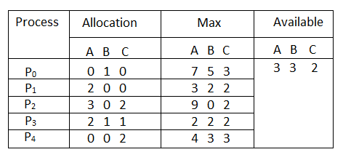
Banker’s Algorithm
Considering a system with 5 processes, and 3 resources of type A, B, C
A: 10 instances
B: 5 instances
C: 7 instances
Suppose at time t₀ following snapshot of the system has been taken:

Slide 46
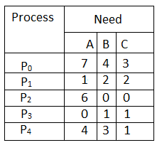
Banker’s Algorithm
Question1. What will be the content of the Need matrix?
Need = Max – Allocation

Slide 47
Banker’s Algorithm
Question2. Is the system in a safe state? If Yes, then what is the safe sequence?
For P₀:
need = 7 4 3
available = 3 3 2
need > available
P₀ must wait

Slide 48
Banker’s Algorithm
For P₁:
need = 1 2 2
After P1 is finished, all allocated resources must be released
available = 3 3 2
need < available
available = 3 3 2 + 2 0 0 = 5 3 2
P₁ can be allocated to resources

Slide 49
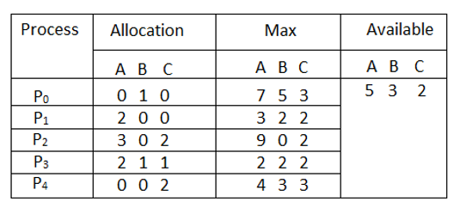
Banker’s Algorithm
For P₂:
need = 6 0 0
available = 5 3 2
need > available
P₂ must wait

Slide 50
Banker’s Algorithm
For P₃:
need = 0 1 1
After P3 is finished, all allocated resources must be released
available = 5 3 2
need < available
available = 5 3 2 + 2 1 1 = 7 4 3
P₃ can be allocated to resources

Slide 51
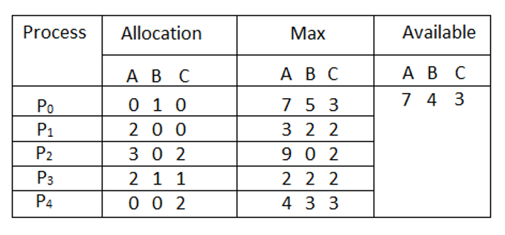
Banker’s Algorithm
For P₄:
need = 4 3 1
After P4 is finished, all allocated resources must be released
available = 7 4 3
need < available
available = 7 4 3 + 0 0 2 = 7 4 5
P₄ can be allocated to resources

Slide 52

Banker’s Algorithm
For P₀:
need = 7 4 3
After P0 is finished, all allocated resources must be released
available = 7 4 5
need < available
available = 7 4 5 + 0 1 0 = 7 5 5
P₀ can be allocated to resources

Slide 53

Banker’s Algorithm
For P₂:
need = 6 0 0
After P2 is finished, all allocated resources must be released
available = 7 5 5
need < available
available = 7 5 5 + 3 0 2 = 10 5 7
P₂ can be allocated to resources
Hence, the system is in safe state!
The safe sequence is P1, P3, P4, P0, P2

Slide 54
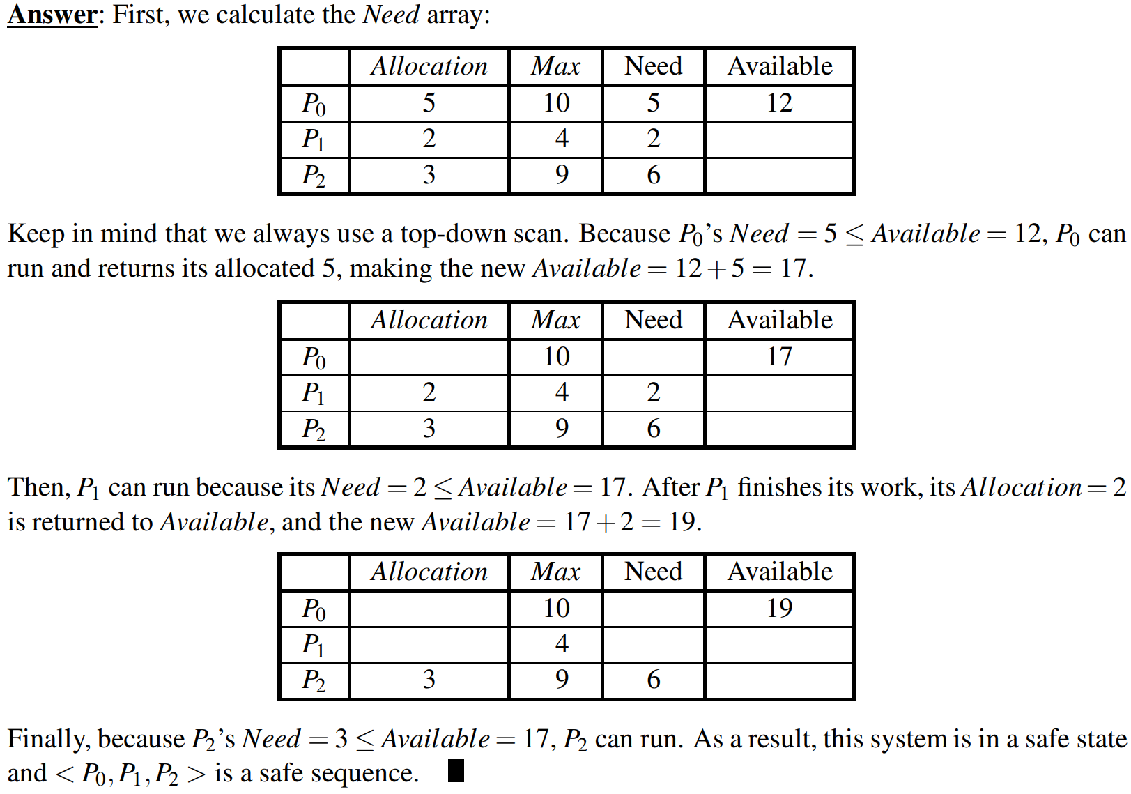
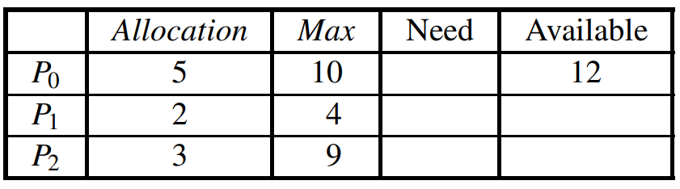
Quiz
Consider a three process system in which processes may request any of 12 drives. Suppose the allocation state given below. Show that the allocation state is unsafe. Will this system deadlock?

Slide 55
Deadlock Detection
Allow system to enter deadlock state
Detection algorithm
An algorithm that examines the state of the system to determine whether a deadlock has occurred
Recovery scheme
Option 1: Process Termination------abort one or more processes to break the circular wait
Option 2: Process Preemption------preempt some resources from one or more of the deadlocked processes

Slide 56
Recovery from Deadlock: Process Termination
Abort all deadlocked processes
What’s drawback?
Break, but at great expense
Abort one process at a time until the deadlock cycle is eliminated
What’s drawback?
Incurs considerable overhead, deadlock-detection algorithm invoked frequently
In which order should we choose to abort?
Priority of the process
How long process has computed, and how much longer to completion
Resources the process has used
Resources process needs to complete
How many processes will need to be terminated
Is process interactive or batch?
Notes:
We should abort those processes whose termination will incur the minimum cost

Slide 57
Recovery from Deadlock: Resource Preemption
Successively preempt some resources from processes and give these resources to other processes until the deadlock cycle is broken
Selecting a victim – minimize cost
Number of resources is holding; amount of time has thus far consumed
Rollback – return to some safe state, restart process from that state
Hard to determine, so total rollback
Starvation – same process may always be picked as victim, include number of rollback in cost factor

Slide 58
Deadlock prevention
Deadlock prevention by ordering the resource requesting

Slide 59
Deadlock prevention
Topic: Deadlock prevention by ordering the resource requesting
Deadlock develops through "bad" ordering of locking operations
"Good" ordering of locking operation:
Processes T1 and T2 lock shared variables A and B in the same order:

Slide 60
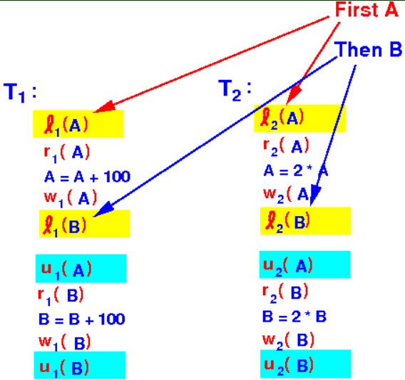
Deadlock prevention

Slide 61
Deadlock prevention
Topic: Deadlock prevention by ordering the resource requesting
Deadlock develops through "bad" ordering of locking operations
"Good" ordering of locking operation:
Processes T1 and T2 lock shared variables A and B in the same order:
Interleaved execution of processes T1 and T2 does not result in deadlock:

Slide 62
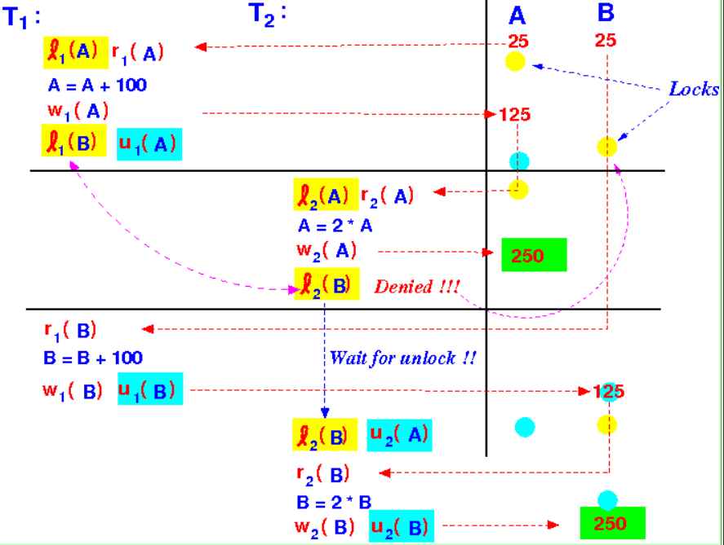
Deadlock prevention

Slide 63
Deadlock prevention
Topic: Deadlock prevention by ordering the resource requesting
Deadlock develops through "bad" ordering of locking operations
"Good" ordering of locking operation:
Processes T1 and T2 lock shared variables A and B in the same order:
Interleaved execution of processes T1 and T2 does not result in deadlock:
"Bad" ordering of locking operation:
Processes T1 and T2 locks shared variables A and B in the opposite order:

Slide 64
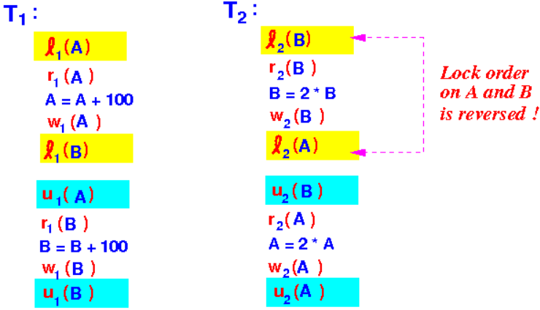
Deadlock prevention

Slide 65
Deadlock prevention
Topic: Deadlock prevention by ordering the resource requesting
Deadlock develops through "bad" ordering of locking operations
"Good" ordering of locking operation:
Processes T1 and T2 lock shared variables A and B in the same order:
Interleaved execution of processes T1 and T2 does not result in deadlock:
"Bad" ordering of locking operation:
Processes T1 and T2 locks shared variables A and B in the opposite order:
An execution that leads to deadlock:

Slide 66
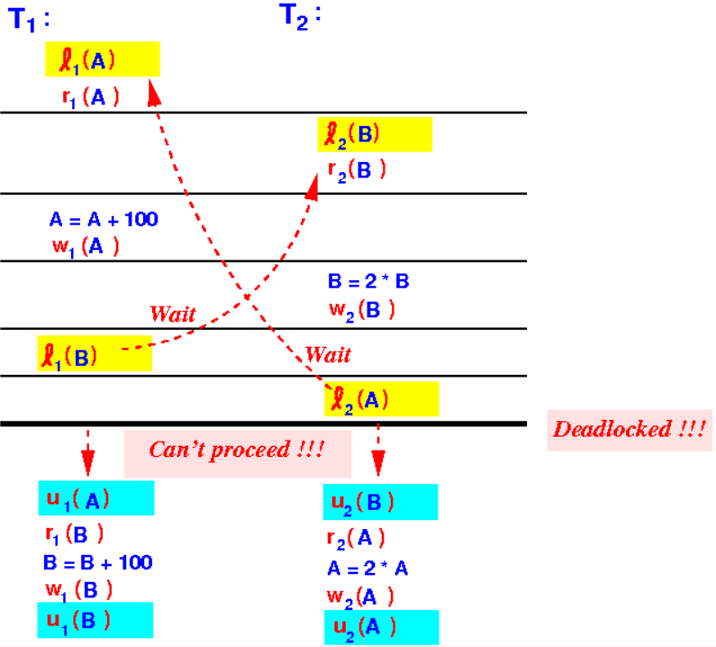
Deadlock prevention

Slide 67
Deadlock prevention
Topic: Deadlock prevention by ordering the resource requesting
Preventing deadlock by imposing an ordering on the shared variables
Example ordering:
Consider shared variables (resources) as a binary number
Example ordering:
Processes must request locks on shared variables in the ordering of variables

Slide 68
Deadlock prevention
A process T wants to lock the shared resources:
Lock request order made by transaction T:
Printer 567
Disk 789
File 123
File 123
Printer 567
Disk 789

Slide 69

Deadlock prevention
Topic: Deadlock prevention by ordering the resource requesting
The cause of the deadlock:
Preventing deadlock by imposing an ordering on the shared variables
Example ordering:
Consider shared variables (resources) as a binary number
Example ordering:
Processes must request locks on shared variables in the ordering of variables
The transactions T1 and T2 have each locked the shared variables in reverse order:

Slide 70
Deadlock prevention
Theorem: Ordered locking on shared resources will prevent deadlock
Claim:
Proof: by contradiction:
Suppose that:
If all processes request locks on shared resources in the order of the resources, then deadlock is not possible.
Processes T1, T2, ..., Tn request locks on shared resources according to the ordering of the database elements and
Transactions T1, T2, ..., Tn are deadlocked

Slide 71
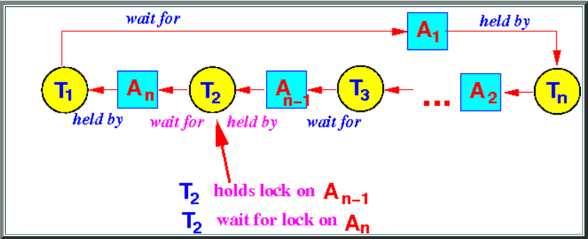
Deadlock prevention
Without lost of generality, let's assume that
The wait-for graph
T1 has locked some variable An and T2 is waiting for a lock on An
T2 has locked some variable An-1 and T3 is waiting for a lock on An-1
T3 has locked some variable An-2 and T4 is waiting for a lock on An-2
...
Tn−1 has locked some variable A2 and Tn is waiting for a lock on A2
Tn has locked some variable A1 and T1 is waiting for a lock on A1

Slide 72
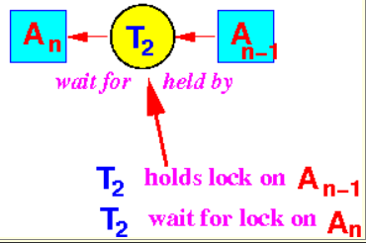

Deadlock prevention
Consider the shared variables that process T2 locks:
T2 has locked the variable An-1 (first) and
T2 is waiting (trying to lock) for the variable An (next)
Since process T2 will lock variable according to their order, we conclude that:

Slide 73
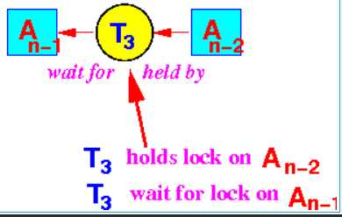

Deadlock prevention
Consider the shared variables that process T3 locks:
T3 has locked the variable An-2 (first) and
T3 is waiting (trying to lock) for the variable An-1 (next)
Since process T3 will lock variable according to their order, we conclude that:
Therefore, we have that:

Slide 74
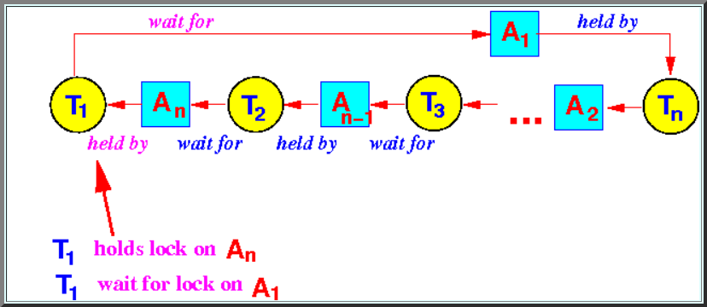


Deadlock prevention
But we also have:
we conclude that:

Slide 75

Deadlock prevention
Therefore, we have that:
we conclude that:
And we have a contradiction:
Therefore:
The assumption that n processes can be involved in a deadlock is wrong
So deadlock is not possible

Slide 76
Deadlock prevention
Preventing deadlock with timestamps: the wait-die method

Slide 77

Wait-Die Method
Timestamped processes:
Each process is assigned a unique increasing timestamp
Important fact:
An earlier process receives a smaller timestamp
Purpose of the time stamp
To give older processes (= processes with smaller timestamps) a higher priority over "younger" processes

Slide 78
Wait-Die Method
The Wait-die locking rule:
When an older process tries to lock a variable that has been locked by a younger process
When a younger process tries to lock a variable that has been locked by an older process
The older process will wait until the lock is released (by the younger process)
The younger process will die (= abort)

Slide 79
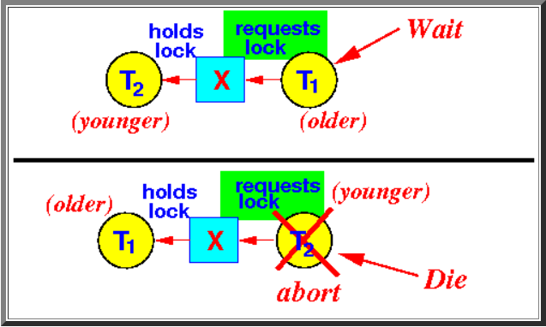
Wait-Die Method
The Wait-die locking rule:
The younger process will die (= abort)

Slide 80
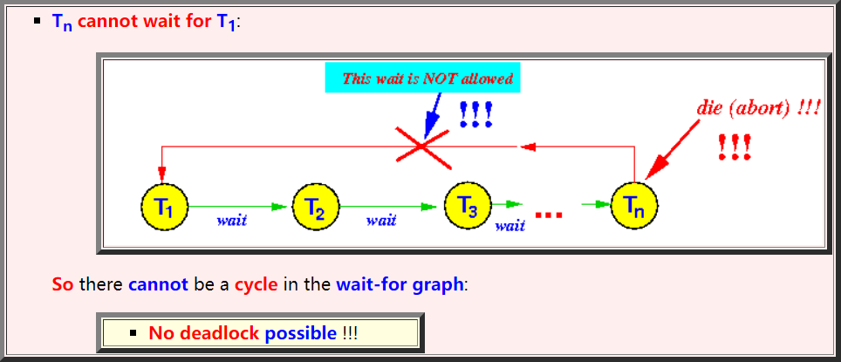
Wait-Die Method
The Wait-die locking rule will prevent the development of deadlock because:

Slide 81
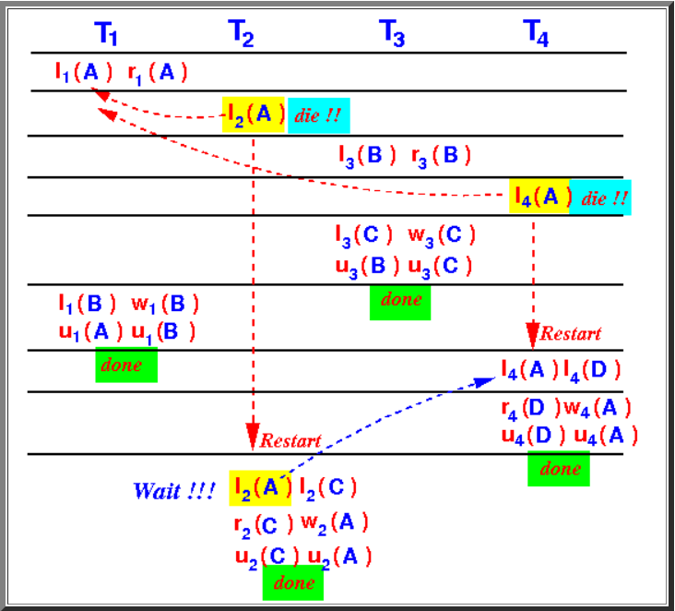
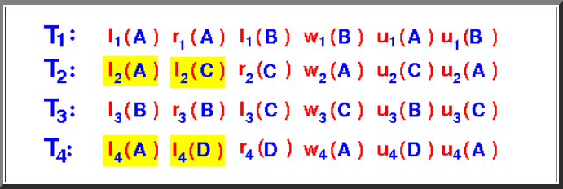
Wait-Die Method
Example: wait-die locking
Example: execution that obeys the wait-die rule

Slide 82
Wait-Die Method
Important note:
When a process is aborted and restarts
The process will retain its (old) timestamp !!!
Therefore:
Eventually, a process will become the "oldest" process and will complete execution !!!

Slide 83
Deadlock prevention
Preventing deadlock with timestamps: the wound-wait method

Slide 84
Wound-Wait Method
The Wound-wait locking rule:
When an older process tries to lock a variable that has been locked by a younger process
When a younger process tries to lock a variable that has been locked by an older process
The older process will wound (= kill / abort) the younger process)
The younger process will wait until the lock is released (by the older process)

Slide 85
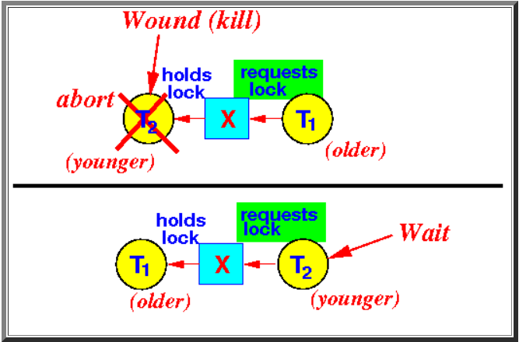
Wound-Wait Method
The Wound-wait locking rule:

Slide 86
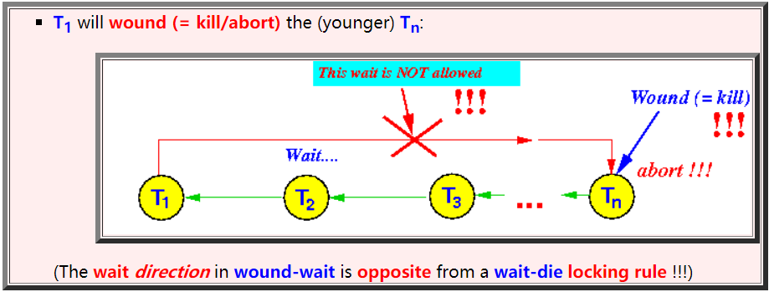
Wound-Wait Method
The Wound-wait locking rule will prevent (forbid) the development of deadlock because:
In both schemes (wait-die and wound-wait), the younger process will get aborted
The older transaction is not be aborted !!!

Slide 87
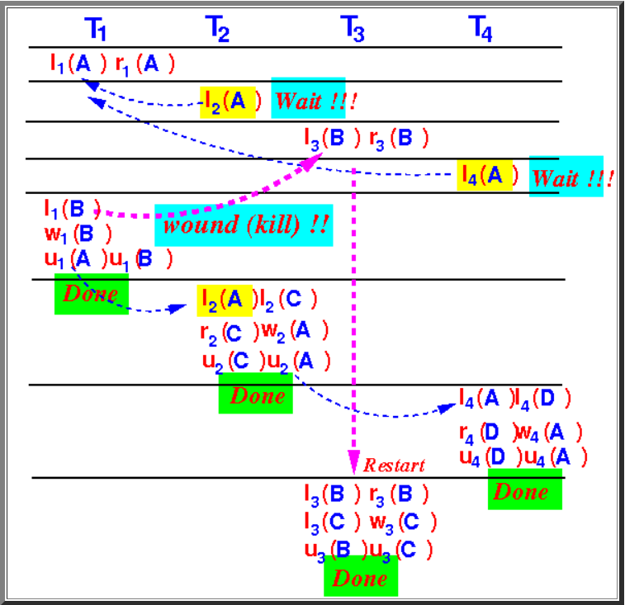
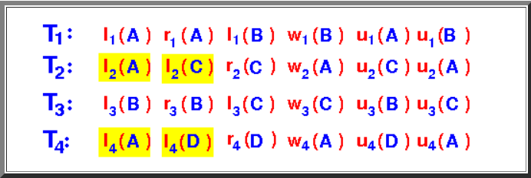
Wound-Wait Method
Example: wound-die locking
Example: execution that obeys the wound-die rule

Slide 88
Deadlock prevention
Comparing the wait-die and wound-wait schemes

Slide 89
Comparing
Similarity:
In both the wait-die and the wound-wait scheme
Both schemes are fair
The older process will "win" over the younger process
When processes restart, they keep their timestamps
Eventually, the aborted (younger) processes will become the oldest processes in the system

Slide 90
Comparing
Difference:
Wait-die:
The younger processes are killed when:
Wound-die:
The younger processes are killed when:
It (= the younger process) makes a request for a lock being held by an older process
An older process makes a request for a lock being held by the younger processes

Slide 91
Comparing
The cost of aborting (younger/older) transactions:
Younger processes (having just started running) will typically:
Older processes (having run longer) will typically
hold fewer number of locks and
has read/written fewer number of variables
hold higher number of locks and
has read/written higher number of variables
Older processes (= that started earlier) are more expensive (costly) to be aborted !!!!

Slide 92
Comparing
Which method has higher aborting rate?

Slide 93
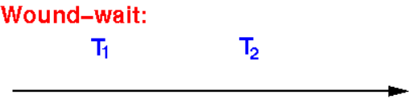
Comparing
Comparing the abort rates of the wait-die and would-wait schemes:
Reasons:
A younger process starts later than an older process:
The number of processes that will be aborted in the wound-wait method will be
lower than number of processes that will be aborted in the wait-die method

Slide 94
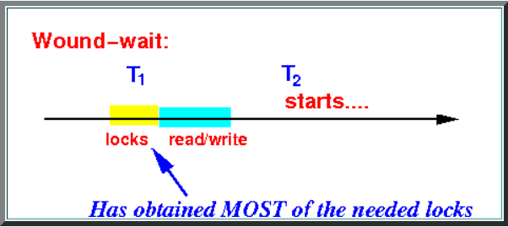
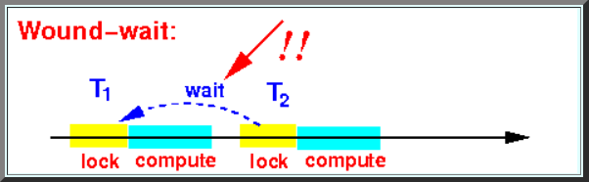
Comparing
By the time that the younger process T2 starts, the older process T1 will have obtained most of their locks:
A younger (just starting) process T2 will make many lock requests !!
In the wound-wait method, a younger (just starting) process T2 will wait (and not abort) if T2 requests a lock held by the older process T1:

Slide 95
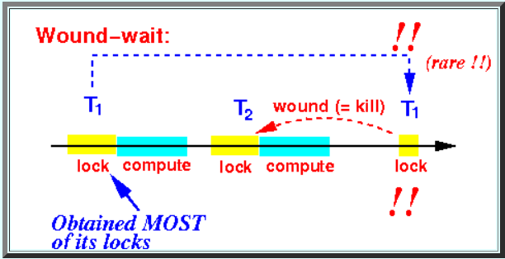
Comparing
An older process (T1) that requests a lock can abort a younger process (T2)
However:
The event that older processes (T1) will request a lock is rare
(because older processes (T1) have obtained most of their locks already)
Therefore:
The number of aborts in wound-wait is relatively low

Slide 96
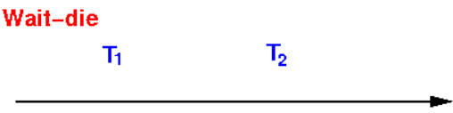
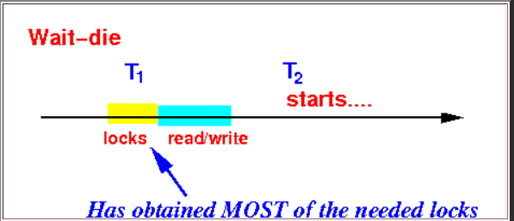
Comparing
Wait-die method will have more aborts:
A younger process starts later than an older process:
By the time that T2 starts, the older process T1 will have obtained most of their locks:
A younger (just starting) process T2 will make many lock requests !!

Slide 97
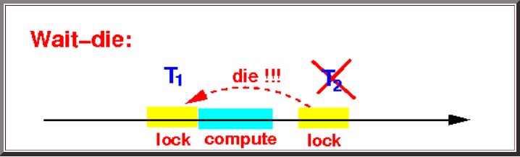
Comparing
In the wait-die method, a younger (just starting) process T2 will die (= abort) if T2 requests a lock held by the older process T1:
Since younger processes makes many lock requests:
There will be more aborts (of young processes) in the wait-die method
Comment:
It looks like that the wound-wait method will have better performance...

Slide 98
Comparing
Comparing the amount of waste work in aborted process in wait-die and wound-wait
The wound-wait method may have fewer aborts, however; it's likely that:
An aborted (younger) process in the wound-wait method has performed more work than an aborted (younger) process in the wait-die method !!!

Slide 99
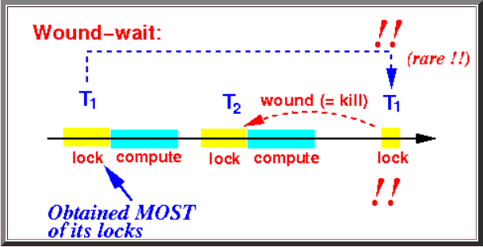
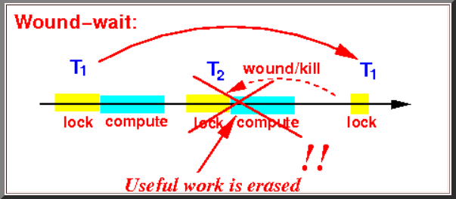
Comparing
Consider a process in the wound-wait method that gets aborted:
I.e.: the aborted process has performed some read/write operations (= useful work):
Notice that the aborted process must hold some locks !!!
The useful work is erased (rolled back) !!!

Slide 100
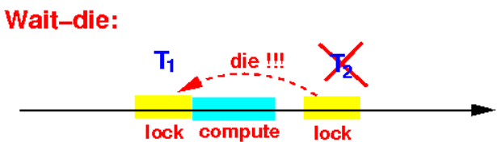
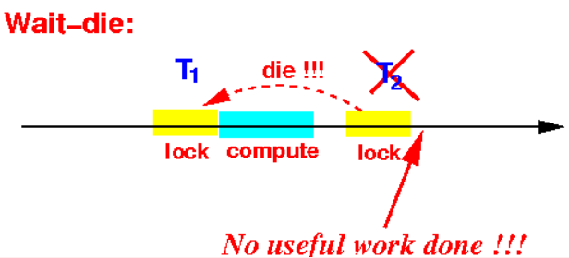
Comparing
Consider a process in the wait-die method that gets aborted:
I.e.: the aborted process has not performed any read/write operations (= no useful work):
Notice that the aborted process may not hold any lock at all !!!

Slide 101
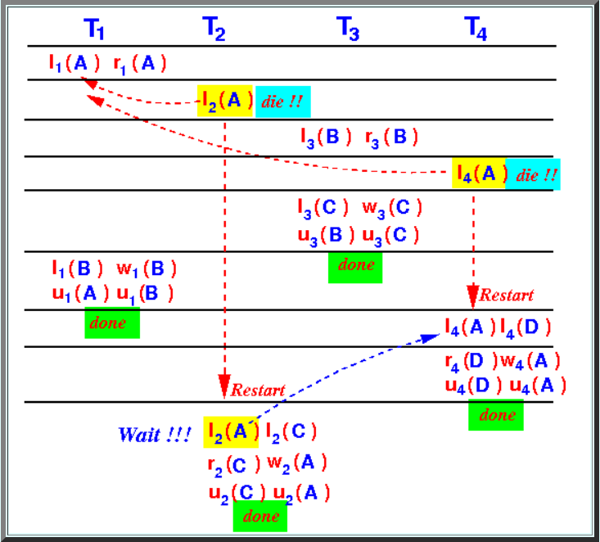
Comparing
Consider the previous examples:
Wait-die locking method
There are 2 transaction aborts (that's 50% of the # processes !!!)
However:
Both aborted processes has done no useful work !!!
(The aborted processes has not performed any read/write operation !!!)

Slide 102
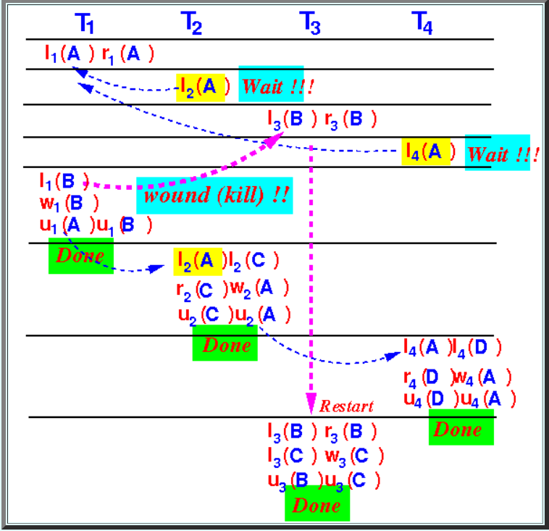
Comparing
Wound-wait locking method
There is only 1 process aborts (less than in wait-die！)
However:
The aborted processes has done some useful work !!!
(Process T3 has read B !!!)

Slide 103
Comparing
Summary
Wait-die has more roll backs; but the processes have performed little to no work
Wound-wait has less roll backs; but the processes that got aborted has done some work !!!

Slide 104
Deadlock Detection
Using timeout to detect deadlock

Slide 105
Deadlock detection
Fact:
When a process T is involved in a deadlock, the transaction T will not finish
Simple way to detect if a process is a candidate to be involved in a deadlock:
Set a timer for each operation
When the timer expires, the transaction is assumed to be involved in a deadlock
Note:
This method is quite reliable because most operations (read/write) does not take very long !!!

Slide 106


Deadlock detection
Example:
MySQL uses timeout to detect deadlocks

Slide 107
Deadlock Detection
Detecting deadlocks using wait-for graphs

Slide 108

Deadlock detection
Wait-for graph is a graph where::
Node represents a process
Edge i ⇒ j represents: the process i is waiting for a lock held by the process j

Slide 109


Deadlock detection
The wait-for graph can be constructed using the information stored in the lock table entries
represents the fact that:

Slide 110

Deadlock detection
Deadlock occurs in a circular wait situation
Each process is waiting for some process to complete
Result: No transaction can proceed forward

Slide 111


Deadlock detection
If the wait-for graph has no cycles, then:
There is no deadlock
Completion order:
T1 will complete first (and releases its locks)
Then T3 can obtain its locks after T1 unlocks and complete next (and releases its locks)
Finally, T2 can obtain its locks after T3 unlocks and complete next (and releases its locks)

Slide 112
Deadlock detection
Deadlock detect in a scheduler
A process scheduler that uses locking to ensure serializability must
Maintain a wait-for graph on all processes
If the wait-for graph contains a cycle:
The scheduler will abort one of the processes in the cycle

Slide 113



Deadlock detection
The process manager will now have to abort some process T1, T2 and T3 that are involved in the deadlock

Slide 114

Revisit: banker’s algorithm
What are safe sequences?

Slide 115

Revisit: banker’s algorithm
1. The Content of the need matrix can be calculated by using the formula given below:
Need = Max – Allocation

Slide 116
Revisit: banker’s algorithm
For process P0, Need = (3, 2, 1) and
Available = (2, 1, 0)
Need <=Available = False
So, the system will move to the next process.

Slide 117
Revisit: banker’s algorithm
For Process P1, Need = (1, 1, 0)
Available = (2, 1, 0)
Need <= Available = True
Request of P1 is granted.
Available = Available +Allocation
= (2, 1, 0) + (2, 1, 2)
= (4, 2, 2) (New Available)

Slide 118
Revisit: banker’s algorithm
For Process P2, Need = (5, 0, 1)
Available = (4, 2, 2)
Need <=Available = False
So, the system will move to the next process.

Slide 119
Revisit: banker’s algorithm
For Process P3, Need = (7, 3, 3)
Available = (4, 2, 2)
Need <=Available = False
So, the system will move to the next process.

Slide 120
Revisit: banker’s algorithm
For Process P4, Need = (0, 0, 0)
Available = (4, 2, 2)
Need <= Available = True
Request of P4 is granted.
Available = Available + Allocation
= (4, 2, 2) + (1, 1, 2)
= (5, 3, 4) now, (New Available)

Slide 121
Revisit: banker’s algorithm
Now again check for Process P2, Need = (5, 0, 1)
Available = (5, 3, 4)
Need <= Available = True
Request of P2 is granted.
Available = Available + Allocation
= (5, 3, 4) + (4, 0, 1)
= (9, 3, 5) now, (New Available)

Slide 122
Revisit: banker’s algorithm
The system allocates all the needed resources to each process. So, we can say that the system is in a safe state.
Now again check for Process P0, = Need (3, 2, 1)
= Available (9, 5, 5)
Need <= Available = True
So, the request will be granted to P0.
Safe sequence: < P1, P4, P2, P3, P0>

Slide 123
Detection-Algorithm Usage
When, and how often, to invoke depends on:
How often a deadlock is likely to occur?
How many processes will need to be rolled back?
one for each disjoint cycle
If detection algorithm is invoked arbitrarily, there may be many cycles in the resource graph and so we would not be able to tell which of the many deadlocked threads “caused” the deadlock.

Slide 124
End of Chapter 8

